Slide 1
Data Representation
Michael Cao

Slide 2
Topic 1: User-defined Data Types
Michael Cao

Slide 3
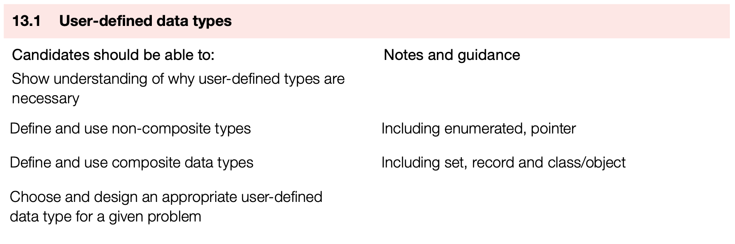
Learning Objective
In this lesson, you will learn:
User-defined data types

Slide 4
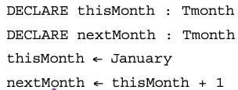

Enumerated Data Type
Non-composite data type can be defined without referencing another data type:
Enumerated data type: defined by a given list of all possible values that has an implied order
It looks like a string but without quotation. It is just a type of user-defined type

Slide 5
Pointer Data Type
Pointer is another non-composite user-defined data type:
Used to reference a memory location
Use ^ to reference as well as dereference
TYPE TIntPt = ^INTEGER
DECLARE MyIntPt: TIntPt
DECLARE Num1, Num2: INTEGER
Num1 ← 100
MyIntPt ← ^Num1
Num2 ← MyIntPt^ * 2

Slide 6
Composite Data Type
A composite data type refers to other data type in its definition:
Record: introduced in AS
Class: include variables of given data types and methods
Set: a given list of unordered elements that can use set of theory operations

Slide 7
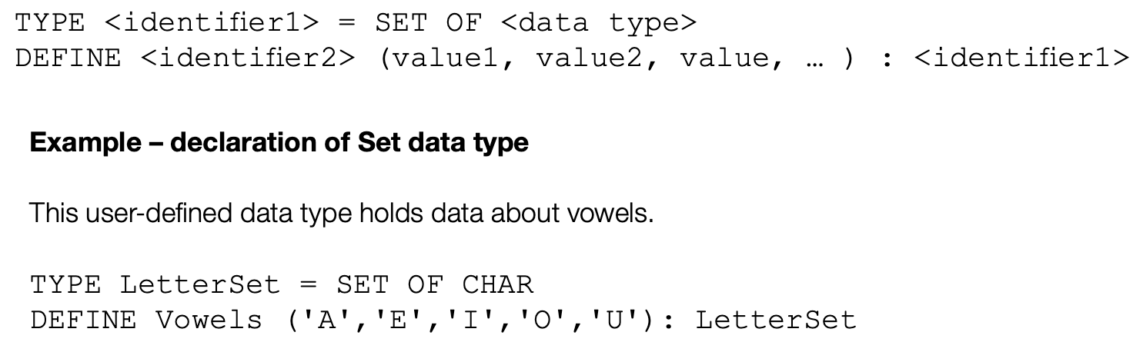
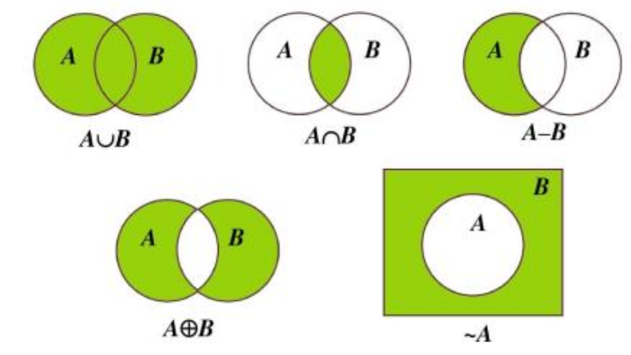
Set
A set is a given list of unordered elements that can use set of theory operations
Duplicated values are not allowed
No organization of the data
Operations include:
Check existence, add new values, remove existing values
Add and subtract between sets
Intersection, union and complement

Slide 8
Activities
Please follow the steps to enhance the understanding of different data types:
Read more codes on textbook and pseudocode guide
Do exercise on handouts
Implement them on python (enumerate, set)
Explore: Other composite or user-defined data type?
Discuss: The need for different type of data type above?
Finish the homework

Slide 9
Topic 2: Floating-Point
Michael Cao

Slide 10
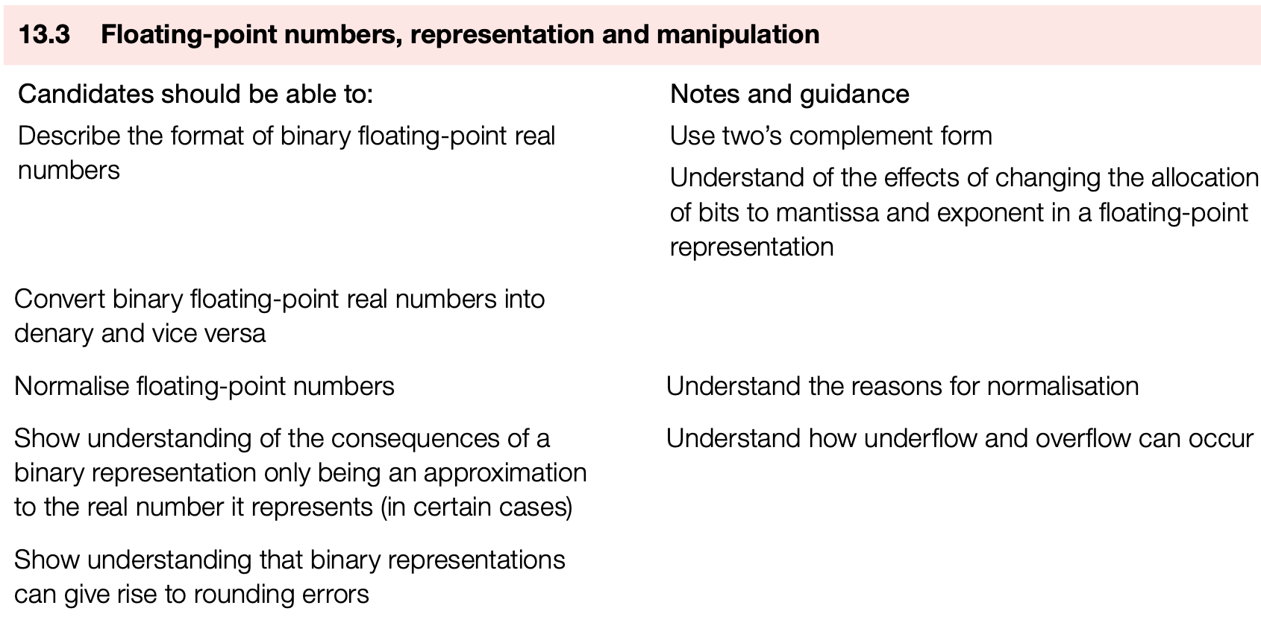
Learning Objective
In this lesson, you will learn:
The representation and manipulation of float-point numbers

Slide 11


Floating-Point Number
We use two’s complement to represent signed numbers, but this limit the range of numbers and cannot indicate fractional values.
Instead, we use scientific notation in binary number system
where M is Mantissa and E is the Exponent
Guess: Why we call a data type in programming language ‘float’

Slide 12
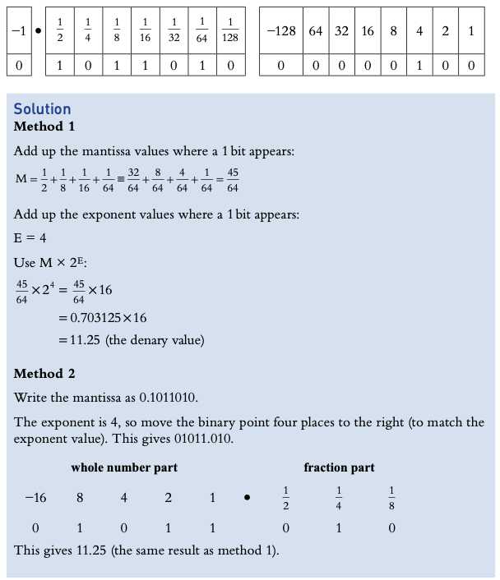
Binary to Denary
The binary numbers are all in two’s complement
There are generally 2 methods for converting, choose the proper one
Use the right as an example
Practice from easy to difficult from example 13.1 to 13.4 on Hodder textbook

Slide 13
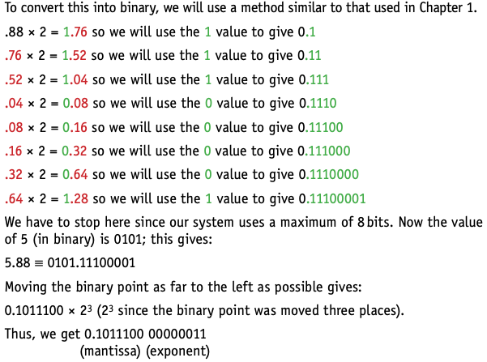
Denary to Binary
There are still 2 methods for converting, choose the proper one
For normalization, start with 0.1 if positive and 1.0 with negative
Practice from example 13.5 to 13.7 (use 13.5 as an example)
Use approximate value if cannot make it so accurate (take 5.88 as example)

Slide 14
Potential Problems
During the calculation process, please summarize the potential problems before we give the conclusion
Rounding error: cannot convert the denary number into an exactly binary equivalent
Precision vs. Range: trade-off in limited bit length
Overflow and Underflow: result is too big or small the represent
Zero cannot be represented

